Slide 1
TEAM 1
SAIPRIYA.B
PAVITHRA VENKATESAN
MADHURI SANAPALA
AAQIB UR REHMAN
ARVETI NAVEEN

Slide 2
HARDWARE

Slide 3
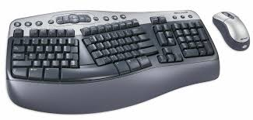


HARDWARE
Input Devices: An input device is a piece of computer hardware equipment used to provide data.
Mechanical Keyboard Membrane Keyboard Multimedia Keyboard

Slide 4

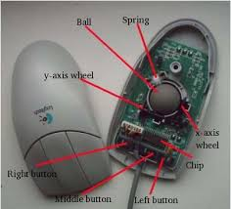
MOUSE
A small handheld device which is used to move the cursor on a computer screen.
Mechanical mouse
Optical Mouse

Slide 5
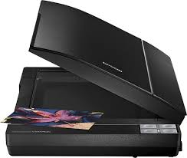

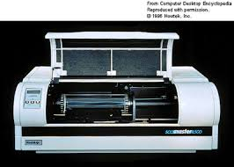
SCANNER
A hardware device that scans documents and converts them into digital data.
Flatbed scanner
Drum scanner
Handheld scanner

Slide 6
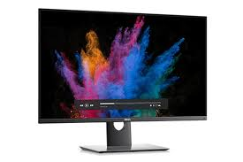
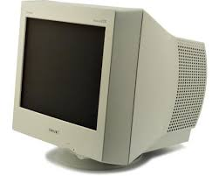
OUTPUT DEVICES
The hardware devices that converts a computer's output to a form that can be seen or heard on the computer. MONITOR
CRT Monitor
LCD Monitor

Slide 7
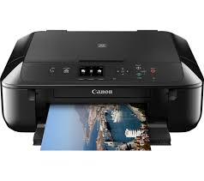
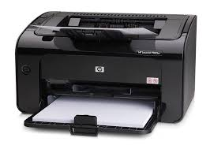
PRINTER
A printer is a device that accepts text and graphic output from a computer and transfers the information to paper.
Ink jet printer
Laser Printer

Slide 8
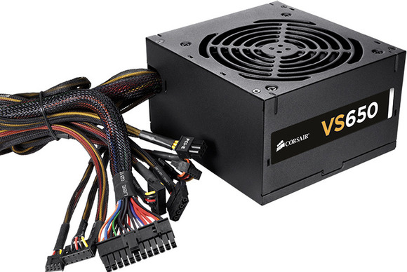
SMPS
Switch Mode Power Supply(SMPS) is a type of Power Supply Unit (PSU) that uses some kind of switching devices to transfer electrical energy from source to load.

Slide 9
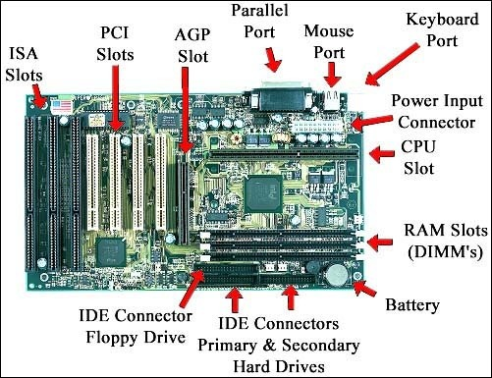
MOTHER BOARD

Slide 10
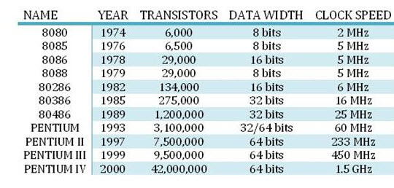
MICROPROCESSOR

Slide 11
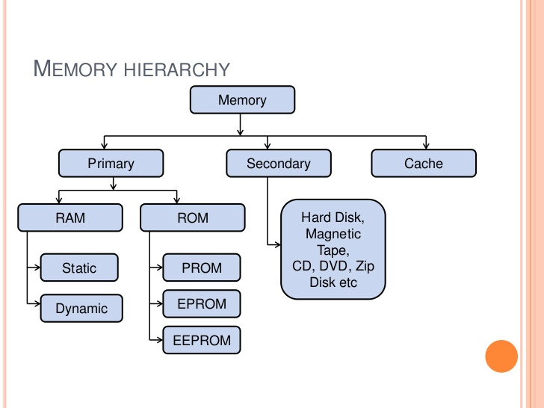
MEMORY

Slide 12
WINDOWS

Slide 13
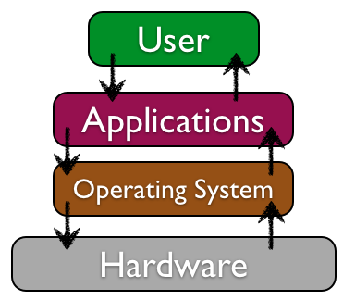
OPERATING SYSTEM
Operating System: An operating System is a software, consisting of programs and data, that runs on computers, manages computer H/W resources, and provides common services for execution of various application software.
Types Of Operating System
Network O.S
Real Time O.S
Distributed O.S
Multi-Tasking O.S

Slide 14
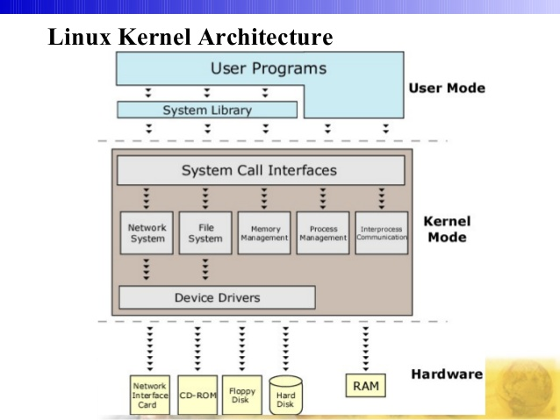
KERNEL ARCHITECTURE
Kernel is the core component of the O.S.
It acts as a bridge Between Applications and actual data processing which is done at the H/W level.
It provides basic low level operation such as Scheduling threads or routing H/W interrupts.

Slide 15
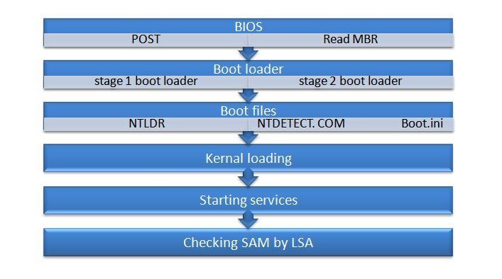
BOOTING PROCESS

Slide 16
FILE SYSTEM
A File system is a method of storing the data and organizing the computer files and the data they contain to make it easy to find and access them
FAT
Partition Boot Record
FAT1
FAT2 duplicate
Root Folder
All Files
NTFS
Partition Boot Record
Master File Table
System File Data
File Area

Slide 17
PROCESS MANAGEMENT
schedule
New
created
Ready
Running
completed
Termination
Priority
time quantum
I/O completed
I/O request
resume
suspend
Wait
Suspend
Ready
resume
suspend
Suspend Wait
Process completed I/O
but still in suspend

Slide 18
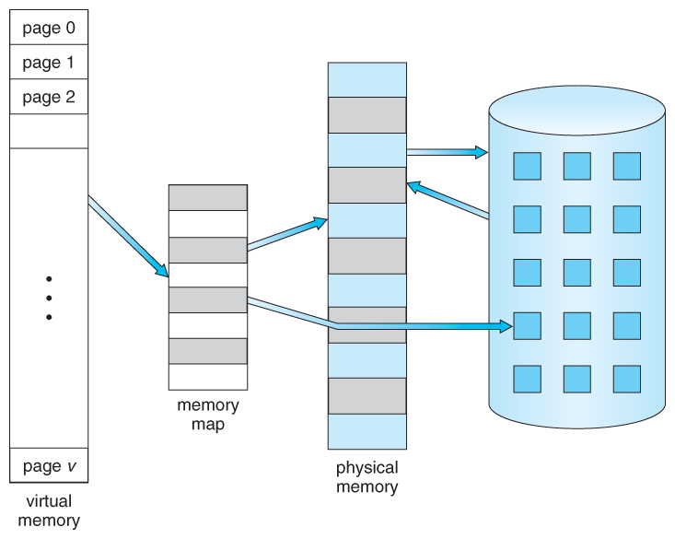
MEMORY MANAGEMENT
Page table
Swap in
Physical Memory
Disk
Swap Out
Disk drive

Slide 19
LINUX

Slide 20
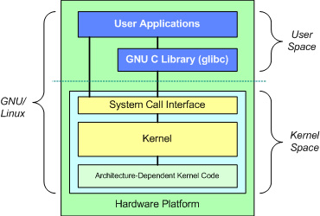
LINUX SUBSYSTEM

Slide 21
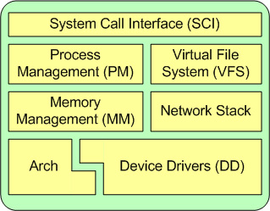
KERNEL SUBSYSTEM

Slide 22
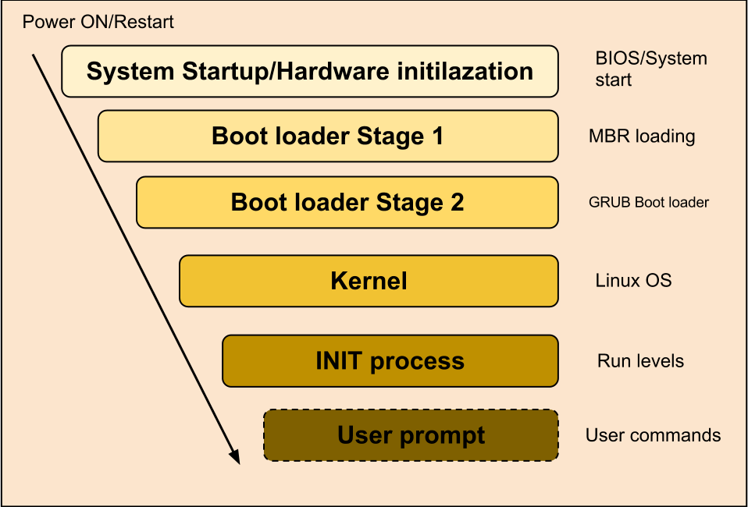
LINUX BOOTING PROCESS

Slide 23
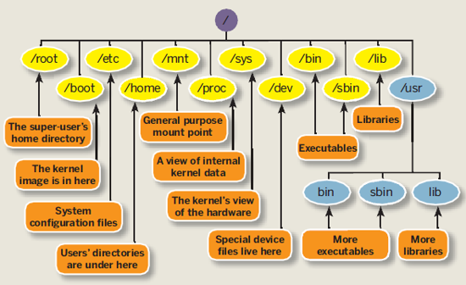
LINUX FILE SYSTEM HIERARCHY

Slide 24
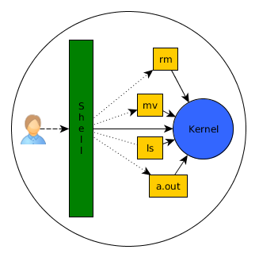
SHELL
A Unix Shell is command Line Interpreter.
It provides a traditional User Interface for the Unix O.S and for Unix-like systems.
Types Of Shells
Ash
Bash
Korn
T-shell
C-Shell
Z-Shell

Slide 25
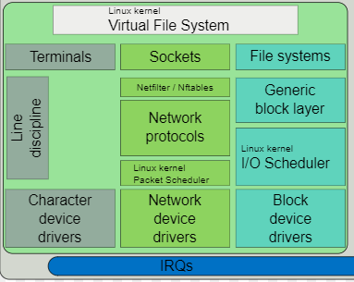
DEVICE MANAGEMENT

Slide 26
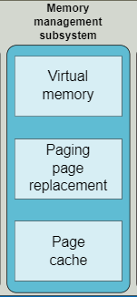
MEMORY MANAGEMENT
Physical Memory refers to the RAM installed in the system.
Virtual Memory extends the available memory of the computer by storing the inactive parts of the content RAM on a disk.

Slide 27
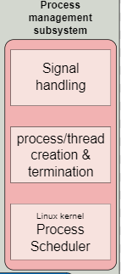
PROCESS MANAGEMENT
Process: An instance of a program is called a process.
The O.S tracks processes through a 5 digit ID number known as PID or process ID. Each process in the system has a PID.
Types Of Process
Child
Daemon
Orphan
Zombie
Interactive
Batch or Automatic
Real Time

Slide 28
NETWORK
FUNDAMENTALS

Slide 29
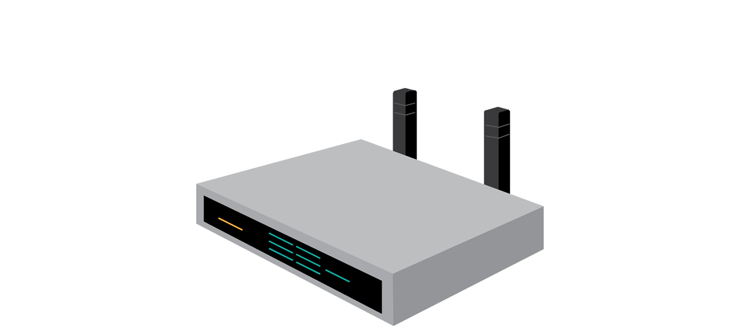
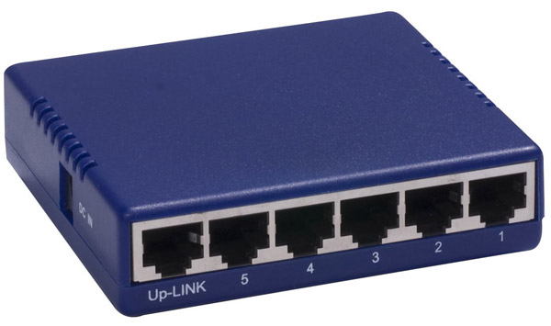
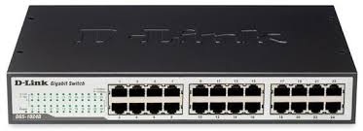

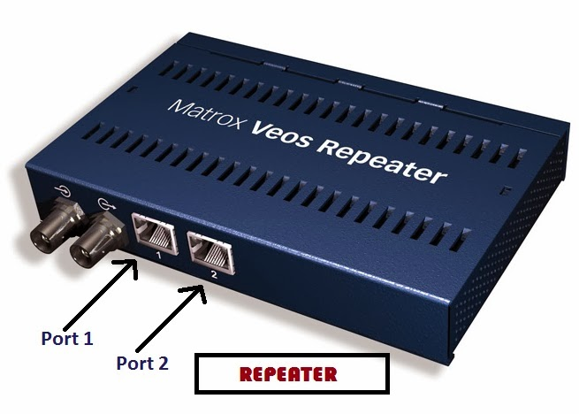
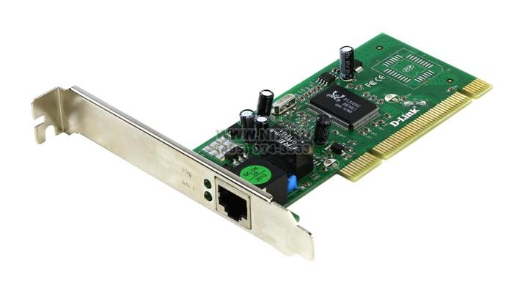
NETWORK DEVICES
A network is defined as a group of two or more computer systems linked together.
Hub
Switch
Router
NIC
Bridge

Slide 30
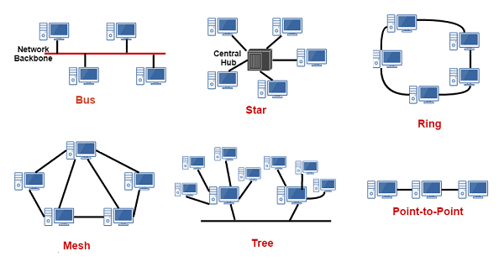
NETWORK TOPOLOGIES

Slide 31
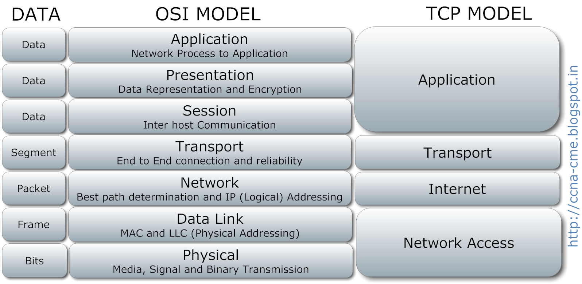

Slide 32
NETWORK
SERVICES

Slide 33
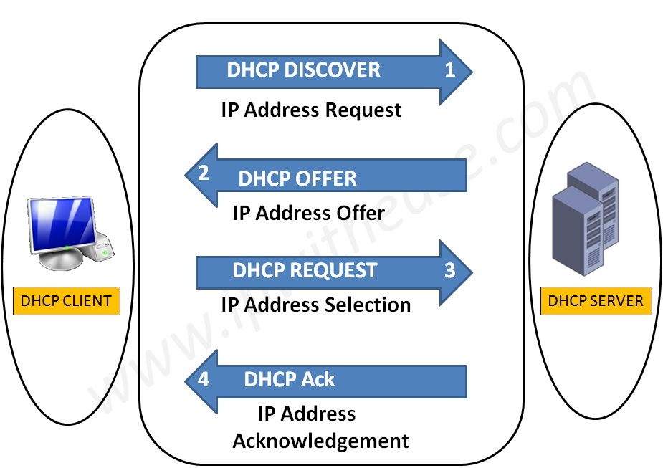
DHCP ARCHITECTURE
DHCP contains:
DHCP clients
DHCP servers
DHCP relay agents on a network
Clients interact with servers using DHCP messages
To obtain and renew IP address leases.
DHCP Standard includes 3 different types of address allocation mechanism
Manual Allocation
Dynamic Allocation
Automatic Allocation

Slide 34
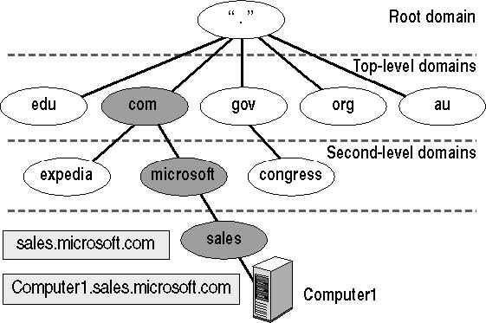
DNS HIERARCHY
DNS uses a hierarchy to manage its distributed database system. The DNS hierarchy, also called the domain name space, is an inverted tree structure, much like eDirectory.

Slide 35
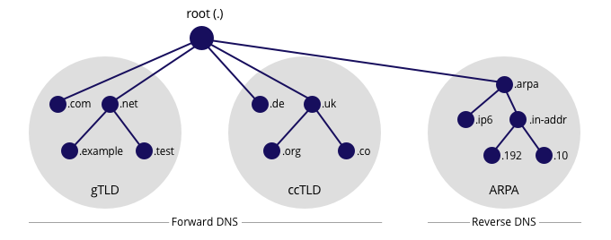
DNS LOOKUP

Slide 36
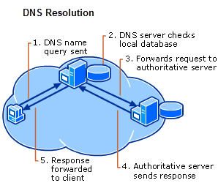
DNS RESOLUTION

Slide 37

LDAP (Lightweight Directory Access Protocol)
Lightweight Directory Access Protocol uses client-server architecture.
It is used to manage and access distributed directory over IP network.
It is similar to telephone directory containing contact numbers and addresses of the subscribers.
It provides directory service with systematic set of records organized in hierarchical structure.

Slide 38
LDAP ARCHITECTURE
Root Node
Branch Node
Leaf Nodes

Slide 39
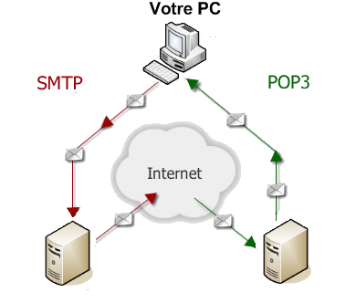
MAIL SERVICES
Three major mail services:
Simple Mail Transfer Protocol
SMTP
Post Office Protocol
POP3
Internet Mail Access Protocol
IMAP or IMAP4
Mail Services

Slide 40
SLIDE NO: 3
PROXY SERVER
A proxy server is a dedicated computer or a software system running on a computer that acts as an intermediary between an endpoint device, such as a computer, and another server from which a user or client is requesting a service.
Functionalities:
Firewall and network data filtering.
No anonymous surfing
Data caching.
Types of proxies :
Forward proxy.
Open proxy.
Reverse proxy.

Slide 41
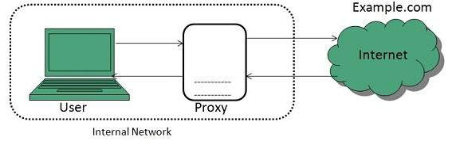
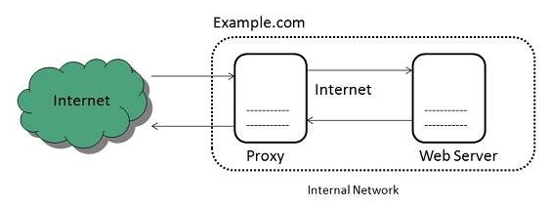
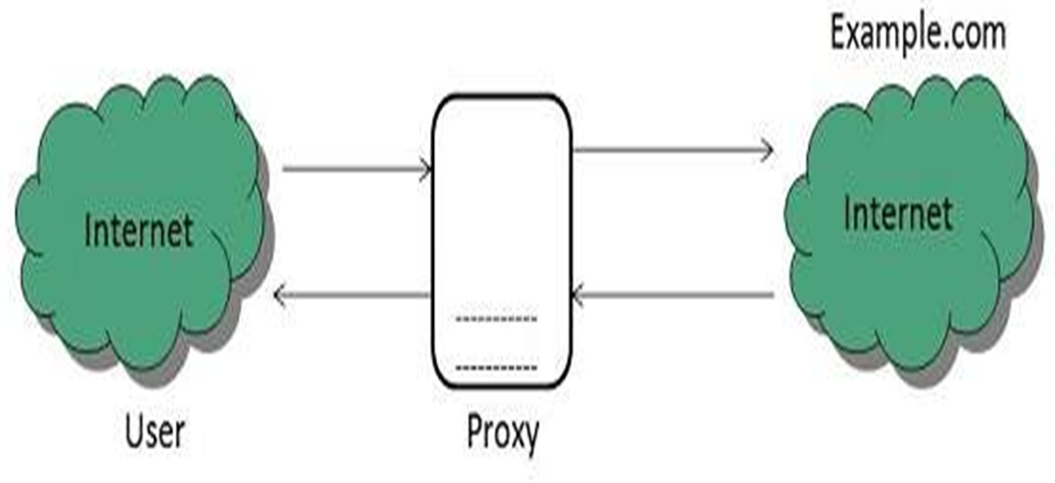
FORWARD PROXY
REVERSE PROXY
OPEN PROXY
SLIDE NO: 4

Slide 42
DBMS

Slide 43

ACID PROPERTIES
Atomicity
Consistence
Isolation
Durability

Slide 44
Normalization: Normalization is dividing the table or relation in multiple tables.
Anomalies in DBMS :
There are three types of anomalies that occur when the database is not normalized. These are –
Insert
Update
Delete
Normalization
Here are the most commonly used normal forms:
First normal form(1NF)
Second normal form(2NF)
Third normal form(3NF)

Slide 47
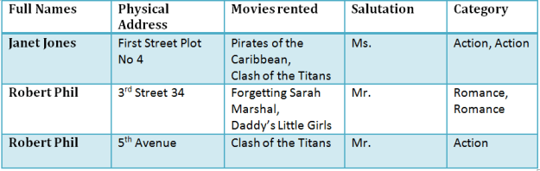
NORMALIZATION

Slide 48
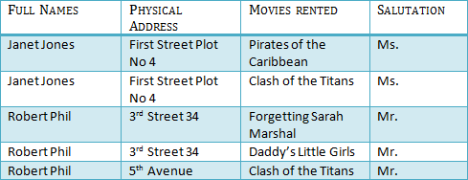
1NF (FIRST NORMAL FORM)
Rule 1- Each table cell should contain a single value.
Rule 2- Each record needs to be unique.

Slide 49
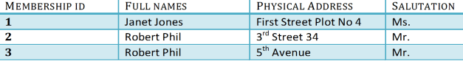
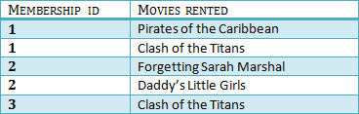
2NF (SECOND NORMAL FORM)
Rule 1- Be in 1NF
Rule 2- Single Column Primary Key

Slide 50
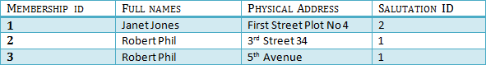
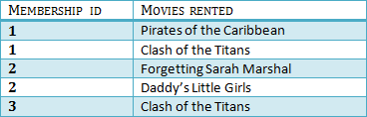
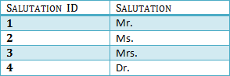
3NF (THIRD NORMAL FORM) RULES
Rule 1- Be in 2NF
Rule 2- Has no transitive functional dependencies

Slide 51
APPLICATION

Slide 52
APPLICATION
Application is a program designed to perform a group of functions, tasks or activities for the benefit of the user.
Examples of an application include a word processor, a spreadsheet, an accounting application, a web browser, a media player, an aeronautical flight simulator, a console game or a photo editor.
There are many types of application like
Desktop application
Web application
Android application etc..

Slide 53
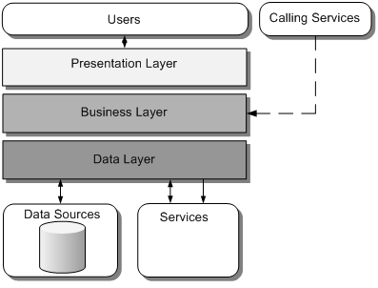
COMPONENTS OF APPLICATION
Presentation layer:
The presentation layer provides the application's user interface.
Business logic layer:
The business layer implements the business functionality of the application.
Data access layer:
The data layer provides access to external systems such as databases.

Slide 54
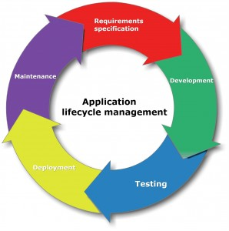

Slide 55
APPLICATION PROGRAM INTERFACE(API)
An application program interface (API) is code that allows two software programs to communicate with each other.
TYPES OF APPLICATIONS
Compiled | Interpreted
A compiled language is a programming language whose implementations are typically compilers translators that generate machine code from source code. | An interpreted language is a type of programming language for which most of its implementations execute instructions directly and freely, without previously compiling a program into machine-language instructions.
Example: C, C++ | Example: Java, C#

Slide 56
APPLICATION SECURITY
Application security is the use of software, hardware, and procedural methods to protect applications from external threats.
ATTACKS
SQL Injection
Cross-site scripting
Denial of Service
Session Hijacking

Slide 57
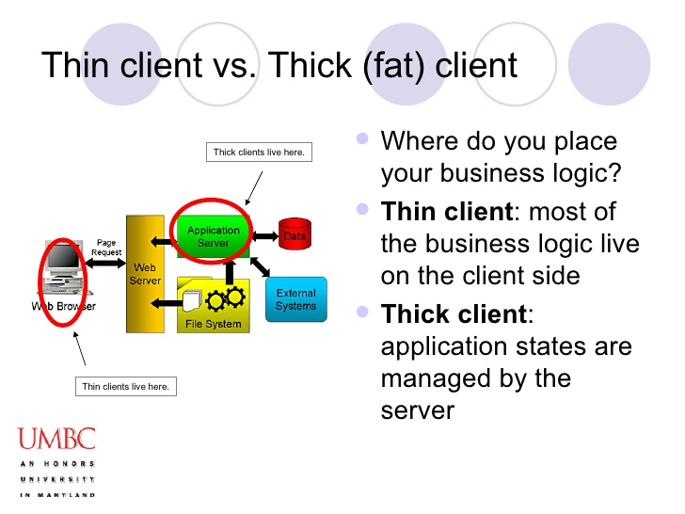
APPLICATION ARCHITECTURE TYPES

Slide 58
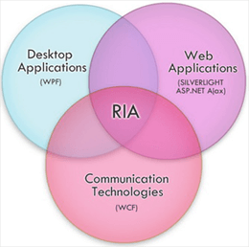

RICH INTERNET APPLICATION
TIER ARCHITECTURE

Slide 59
CHARACTERISTICS
ENTERPRISE APPLICATIONS
Enterprise applications are inherently complex.
Enterprise applications solve business problems.
This involves the safe storage, retrieval, and manipulation of business data.
Reliability
Scalable
Security
Distributed

Slide 60

ARCHITECTURE OF ENTERPRISE APPLICATION

Slide 61
STORAGE

Slide 62

STORAGE

Slide 63


RAID
RAID is a technology that is used to increase the performance and/or reliability of data storage.
RAID LEVELS

Slide 64


RAID LEVELS(Cont.)
RAID 2
Striping with ECC
RAID 3
Byte striping with parity

Slide 65


RAID LEVELS(Cont.)

Slide 66


